Slide 1
Performance Analysis
P. K. Roy
Asst. Professor
Siliguri Institute of Technology

Slide 2
What is it ?
The action or process of performing a task or function.
Airplane Passengers Range (mi) Speed (mph)
Boeing 737-100 101 630 598
Boeing 747 470 4150 610
BAC/Sud Concorde 132 4000 1350
Douglas DC-8-50 146 8720 544
Which plane is the best?
- which metric do we use?
How much faster is the Concorde compared to the 747?
Which plane has the longest route?
Which plane has the best transporting capacity?

Slide 3
Performance Analysis
Measure, Report, and Summarize
Make intelligent choices
See through the marketing hype
Key to understanding underlying organizational motivation
Why is some hardware better than others for different programs? What factors of system performance are hardware related? (e.g., Do we need a new machine, or a new operating system?) How does the Instruction Set Architecture (ISA) affect performance?

Slide 4
Computer Performance
Response Time or Latency — How long does it take for my job to run? — How long does it take to execute a job? — How long must I wait for the database query?
Throughput — How many jobs can the machine run at once? — What is the average execution rate? — How much work is getting done?
Q1: If we upgrade a machine with a new processor what do we increase?
Q2: If we add a new machine to the lab what do we increase?

Slide 5
Execution Time
Response (or Elapsed) Time:
Total time to complete a task including time spent executing
on the CPU, accessing disk & memory, waiting for I/O &
other processes, and OS overhead.
CPU Execution Time (simply CPU time):
Total time CPU spends computing on a given task
(excluding the time for I/O or running other programs).
CPU time = user CPU time + System CPU execution time
= total time CPU spends only in the program
execution + total time OS spends executing tasks
for the program

Slide 6
Exercise:
A program have a system CPU time of 20 seconds, a user CPU time of 90 seconds, and a response time of 150 seconds. Calculate the followings –
i) CPU execution time
ii) time for I/O and other processes

Slide 7
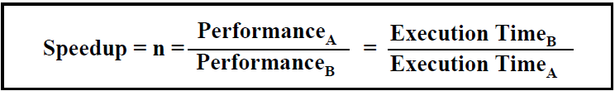
Computer Performance
For some program running on machine A, Performance_{X} = 1 / Execution time_{A}
“A is n times faster than B“ Performance_{A} / Performance_{B} = n
Problem:
machine A runs a program in 20 seconds
machine B runs the same program in 25 seconds
How much faster is A compared to B?

Slide 8


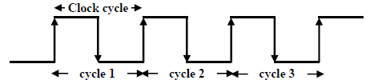


Clock Cycles
Instead of reporting execution time
in seconds, we often use cycles
The CPU clock rate depends on the
specific CPU organization (design) and hardware implementation technology (VLSI) used Clock “ticks” indicate when to start activities (one abstraction):
cycle time = time between ticks = seconds per cycle
clock rate (frequency) = cycles per second (1 Hz. = 1 cycle/sec)
A 200 Mhz. clock has a cycle time

Slide 9
How to Improve Performance
So, to improve performance (everything else being equal) you can either ________ the no. of required cycles for a program, or
________ the clock cycle time or, said another way,
________ the clock rate.
Fill the blanks with either increase or decrease

Slide 10
How to Improve Performance
Put it another way:
Where
N_{cycles} : No. of cycles
t_{clock} : cycle time or clock time (seconds per cycle)
f_{clock} : cycle rate (cycles per second)
CPU time = N_{cycles} * t_{clock} = N_{cycles} / f_{clock}

Slide 11
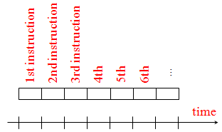
How many cycles are required for a program?
Could assume that no. of cycles = no. of instructions
This assumption is incorrect, different instructions take different amounts of time on different machines. Why?

Slide 12

Different numbers of cycles for different instructions
Multiplication takes more time than addition
Floating point operations take longer than integer ones
Accessing memory takes more time than accessing registers
Thus, a single machine instruction may take one or more CPU cycles to complete termed as the Cycles Per Instruction (CPI).
Instructions Per Cycle = IPC = 1/CPI
Important point: changing the cycle time often changes the number of cycles required for various instructions.

Slide 13
Understanding Cycles
A given program will require
some number of instructions (machine instructions)
some number of cycles
some number of seconds
We have a vocabulary that relates these quantities:
cycle time (seconds per cycle)
clock rate (cycles per second)
CPI (cycles per instruction) a floating point intensive application might have a higher CPI
MIPS (millions of instructions per second) this would be higher for a program using simple instructions

Slide 14
Performance
Performance is determined by execution time
Do any of the other variables equal performance?
No. of cycles to execute program?
No. of instructions in program?
No. of cycles per second?
Average no. of cycles per instruction?
average no. of instructions per second?
Common pitfall: thinking one of the variables is indicative of performance when it really isn’t.

Slide 15
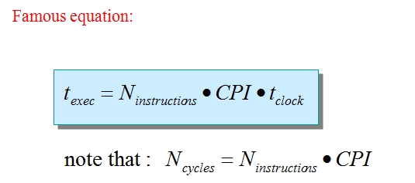
Performance
For a specific program compiled to run on a specific machine (CPU) “A”, has the following parameters:
– The total executed instruction count of the program.
– The average number of cycles per instruction (average CPI or effective CPI).
– Clock cycle of machine “A”

Slide 16

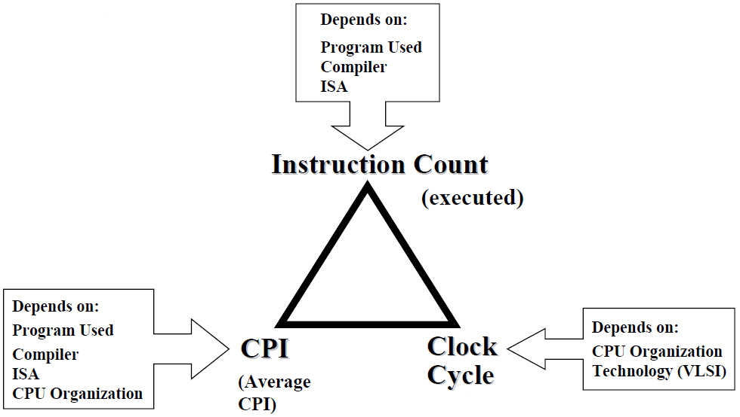
CPU Execution Time

Slide 17
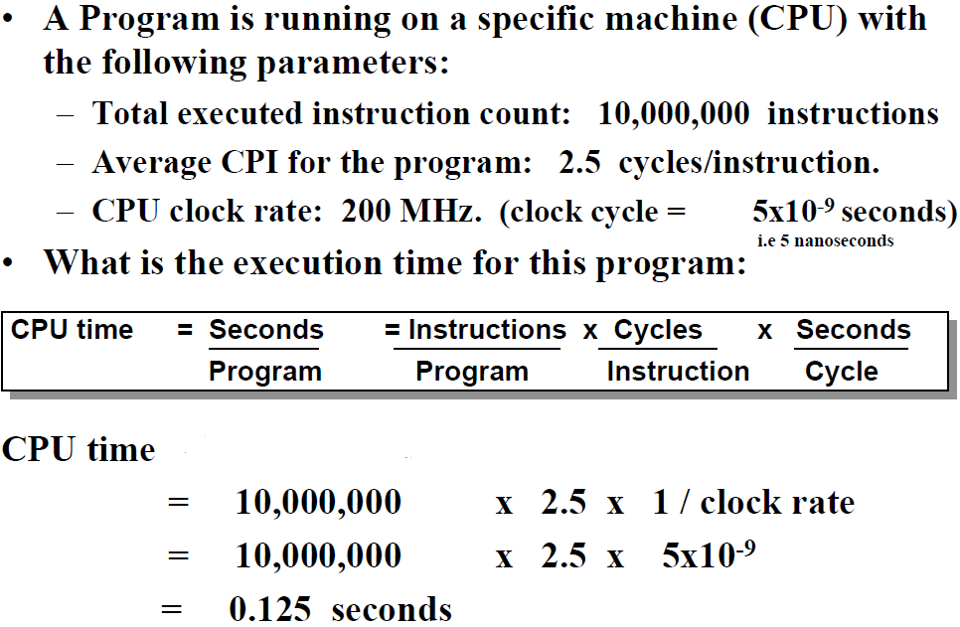
CPU Execution Time: Example

Slide 18
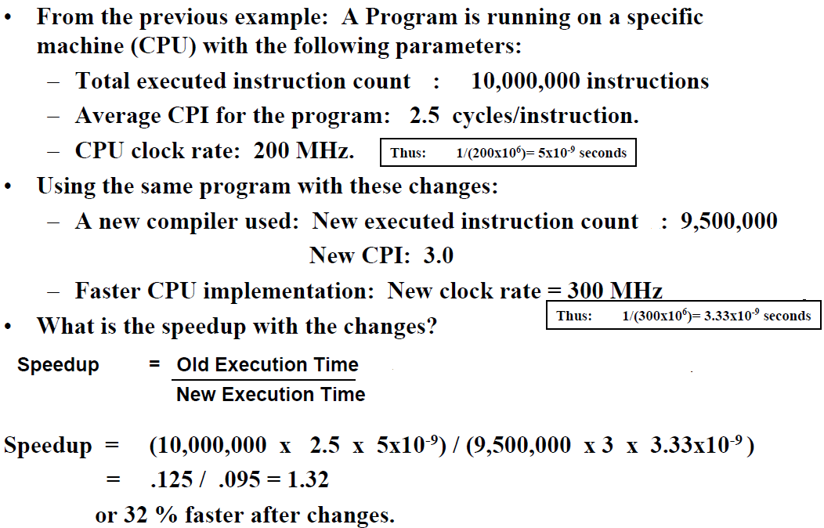
Performance Comparison: Example

Slide 19
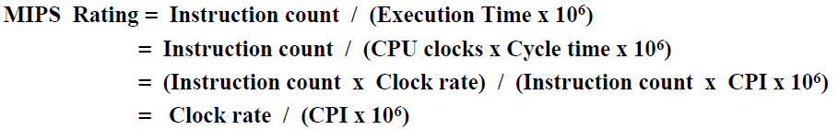
Computer Performance Measures : MIPS (Million Instructions Per Second) Rating
For a specific program running on a specific CPU the MIPS rating is a measure of how
many millions of instructions are executed per second:
Major problem with MIPS rating:
- MIPS rating does not account for the count of instructions executed.
- A higher MIPS rating in many cases may not mean higher performance or better execution time. i.e. due to compiler design variations.
In addition the MIPS rating:
- Does not account for the instruction set architecture (ISA) used.
- Thus it cannot be used to compare computers/CPUs with different instruction sets.

Slide 20
Under what conditions can the MIPS rating be used to compare performance of different CPUs?
The MIPS rating is only valid to compare the performance of different CPUs provided that the following conditions are satisfied:
The same program is used
(actually this applies to all performance metrics)
The same ISA is used
The same compiler is used
⇒ (Thus the resulting programs used to run on the CPUs and obtain the MIPS rating are identical at the machine code level including the same instruction count)

Slide 21
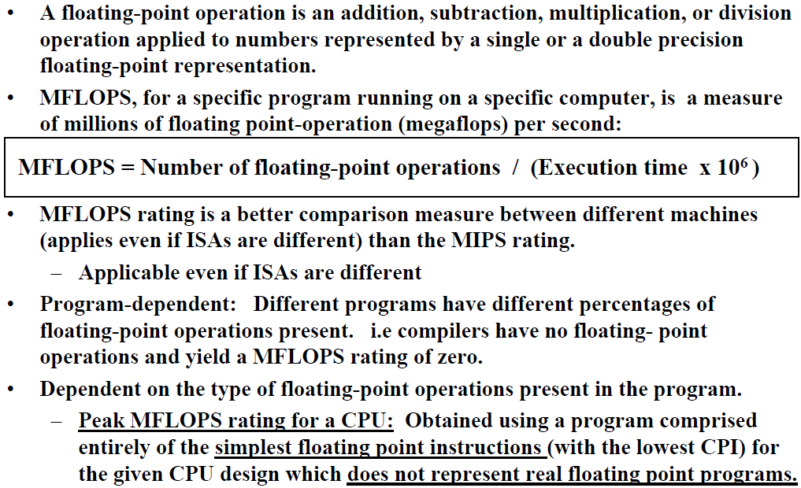
MFLOPS (Million FLOating-Point Operations Per Second)

Slide 22
Exercise
For the multi-cycle MIPS
Load 5 cycles
Store 4 cycles
R-type 4 cycles
Branch 3 cycles
Jump 3 cycles
If a program has
50% R-type instructions
10% load instructions
20% store instructions
8% branch instructions
2% jump instructions
What is the CPI?
Ans: 3.6

Slide 23
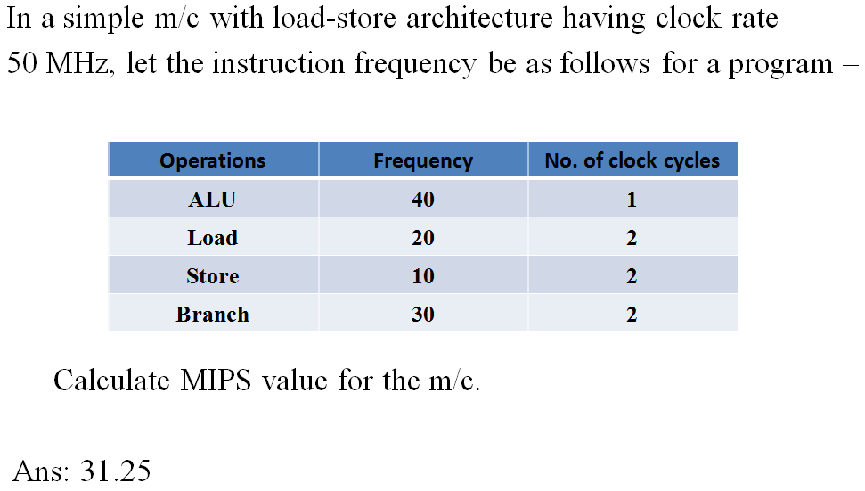
Exercise

Slide 24
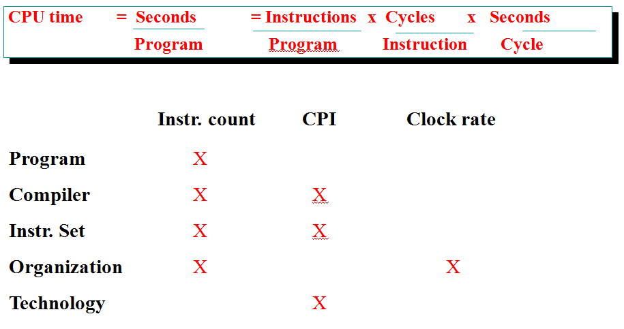
Aspects of CPU Performance

Slide 25
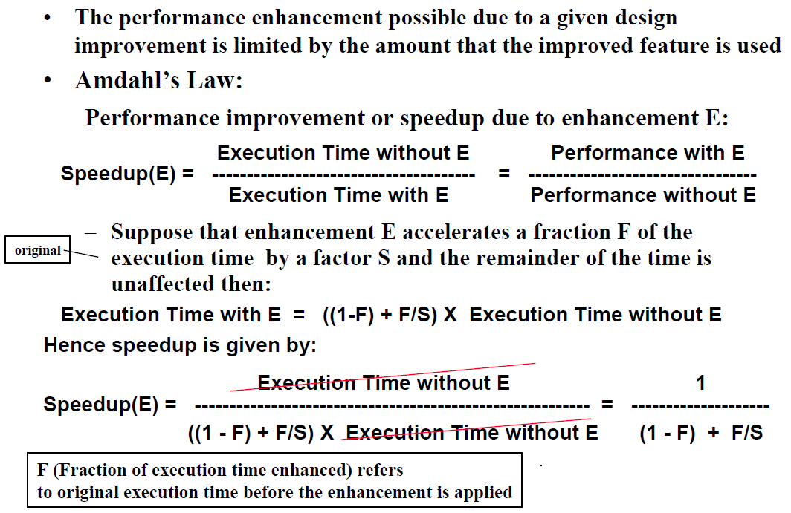
Performance Enhancement Calculations: Amdahl's Law

Slide 26
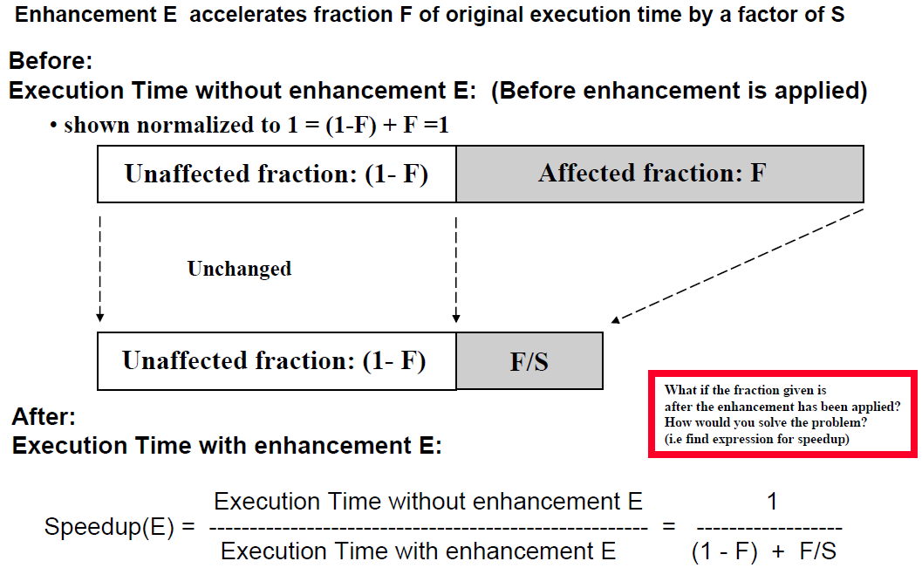
Pictorial Depiction of Amdahl’s Law

Slide 27
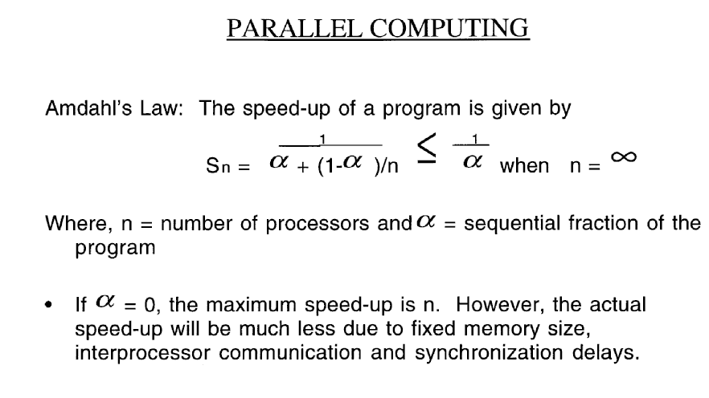
Amdahl’s Law

Slide 28
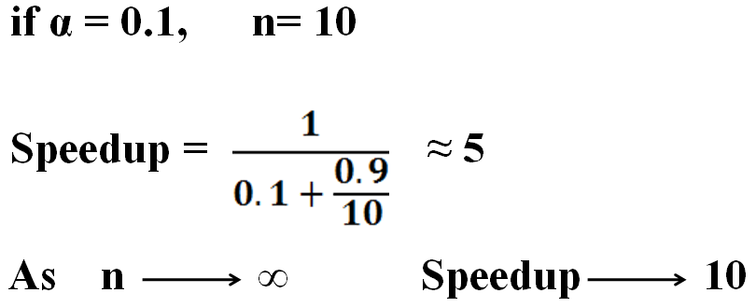
Example

Slide 29
Observations of the Amdahl’s law
Small number of sequential operations can significantly limit speedup achievable by a parallel computer
– This is one of the stronger arguments against parallel computers
Amdahl’s arguments serves as a way of determining whether an algorithm is a good candidate for parallelization
– This argument doesn’t take into account the problem size
– In most applications as data size increases, the sequential part
diminishes.

Slide 30

References
Advanced Computer Architecture – Kai Hwang
Advanced Computer Architectures – Dezso Sima, Peter Karsuk
Computer Architecture & Organization – John P. Hayes
Computer System Architecture – M. Morris Mano
Computer Organization & Architecture – T. K. Ghosh
Computer Organization & Architecture – Xpress Learning

